Slide 1
Morgan Stanley Data Challenge
Naomi Logan, Mika Campbell, Jasmin Jean- Louis, Elon Davis, and Nikira Walter
Faculty Mentor: Dr. Erdi Kara, Spelman College, Mathematics Department
Morgan Stanley Mentor: Patrick Wu

Slide 2
Methodology
Objective
Spatial Data Analysis
Population & Business Analysis
Support financial products expansions strategy by identifying high potential areas for the business' expansion, using the given data.
Augment longitudinal and latitudinal information to the given 1500 Zip codes. Overlay locations over U.S Map with state boundaries and analyze the importance of proximity to and level of accessibility to transportation.
Evaluate the importance of additional population data attributed to the specified Zip codes. Extract mean/median income, financial data, etc.

Slide 3
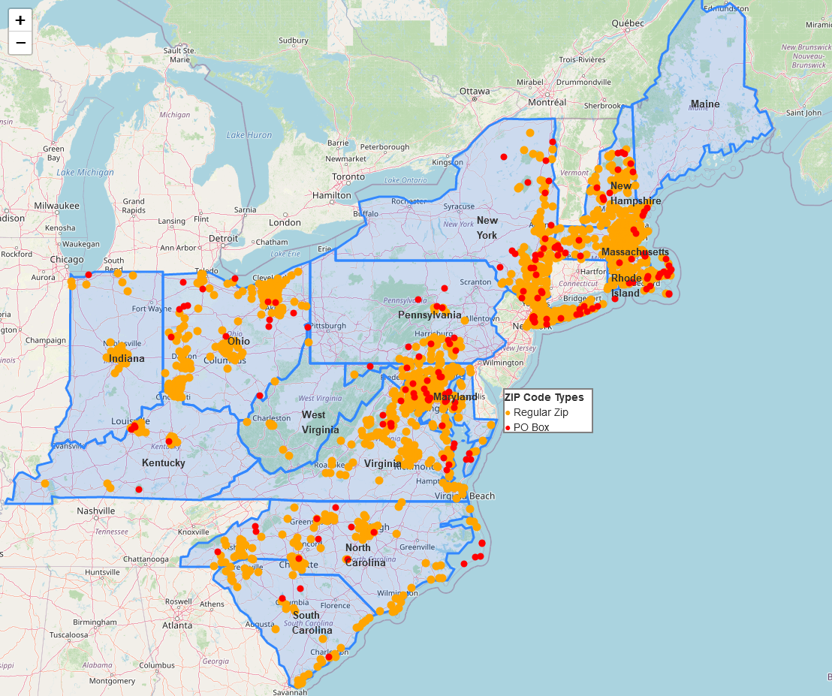
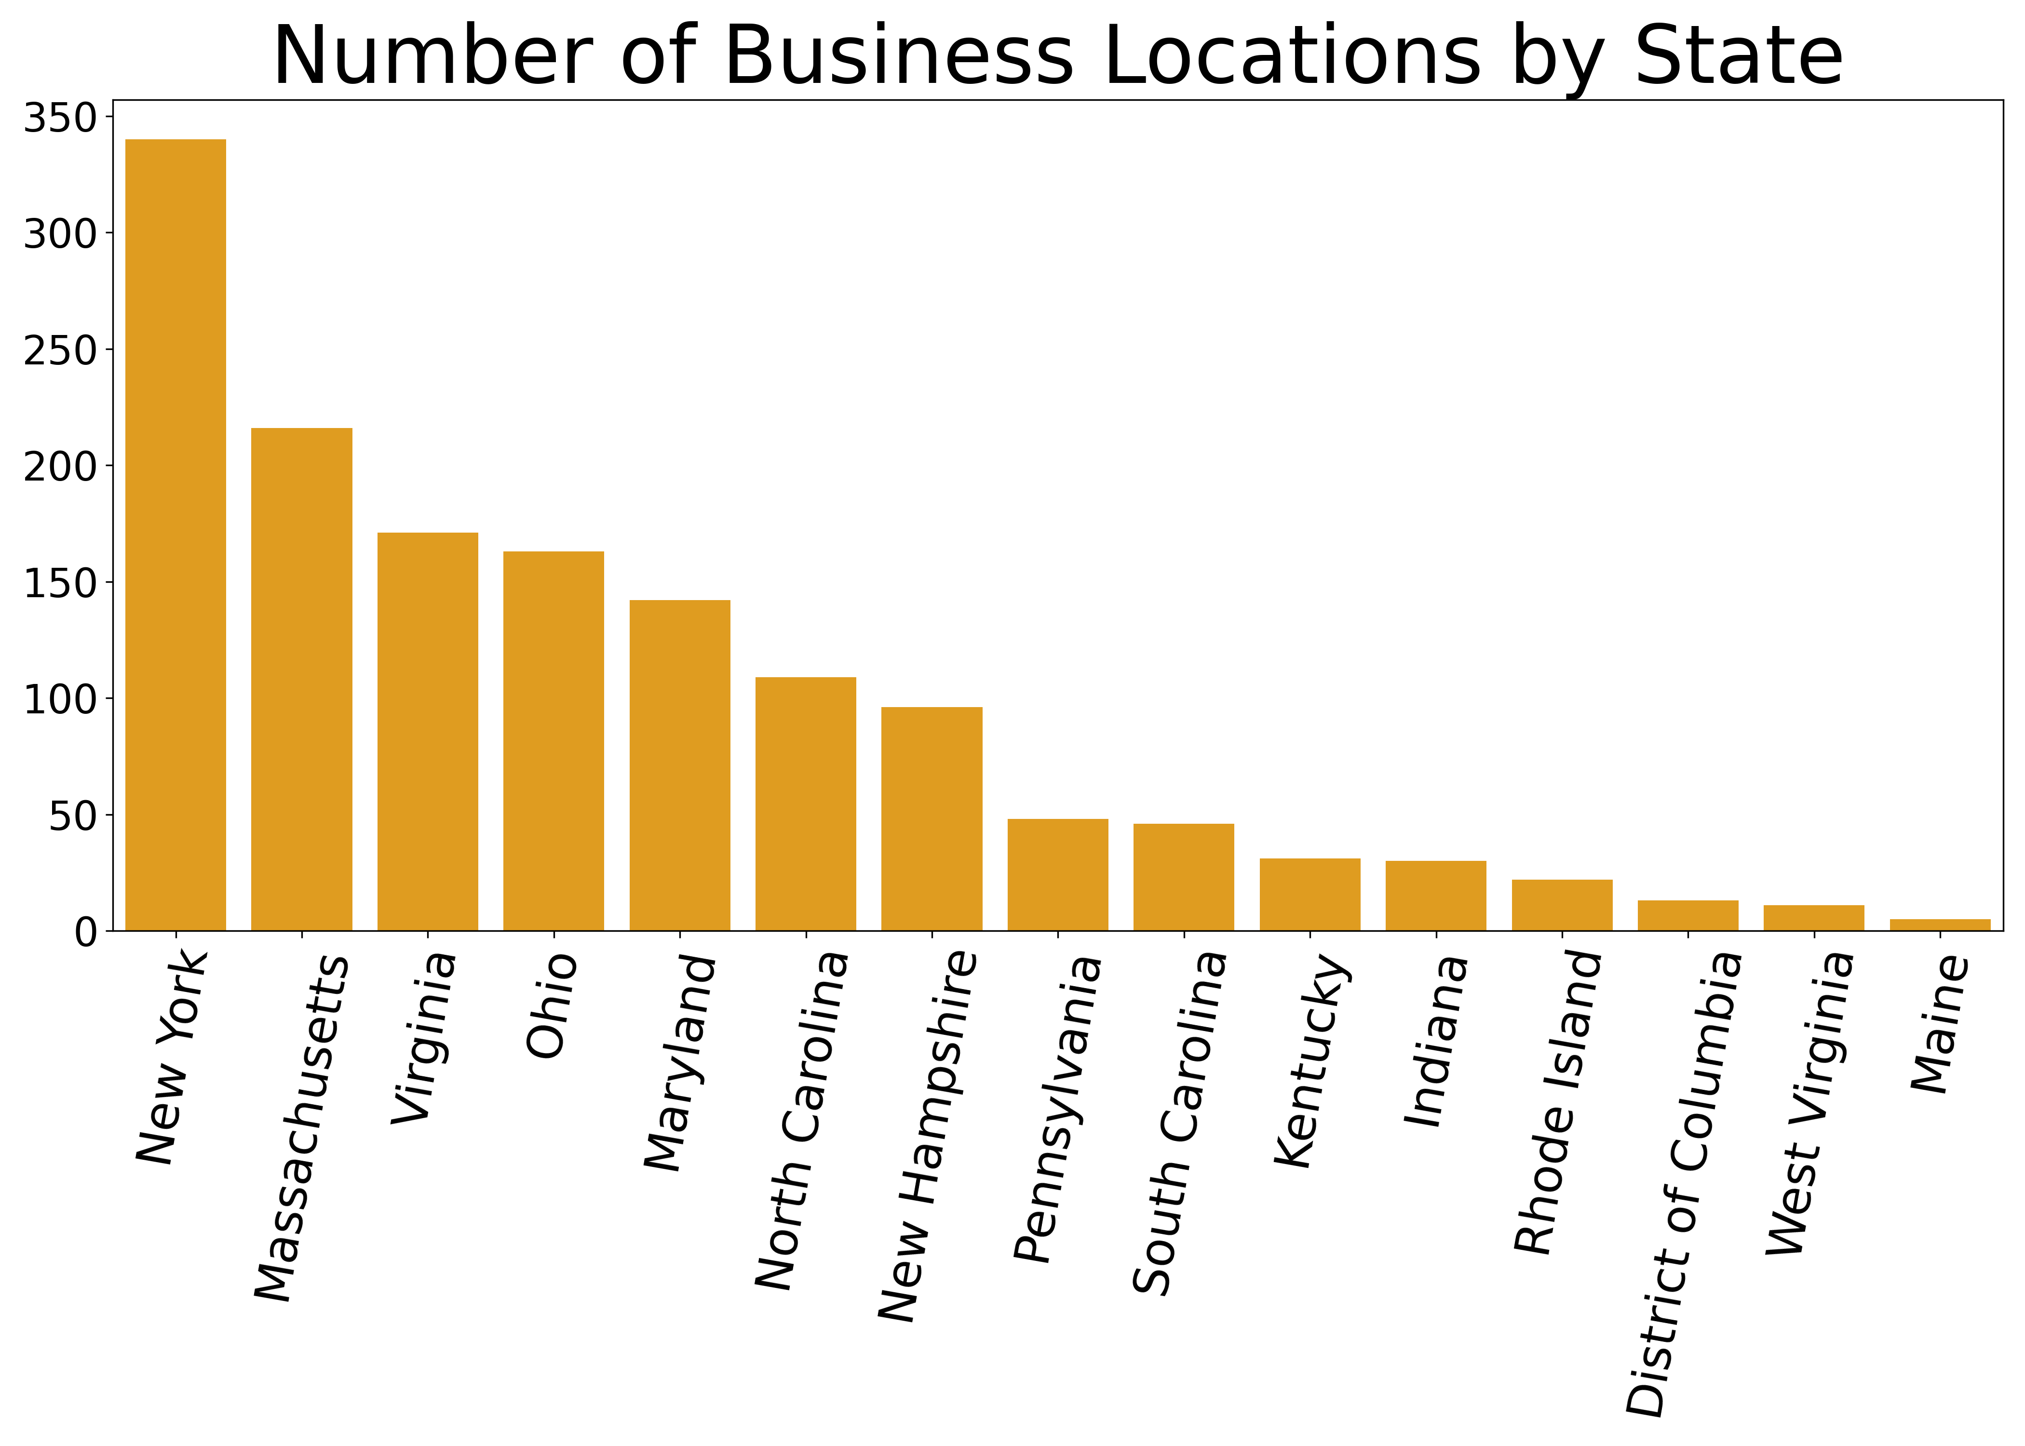
Geospatial Data Analysis
Zip Code | Target | Latitude | Longitude
1026 | 1 | 42.46 | -72.9
1029 | 1 | 42.17 | -73.03
1035 | 1 | 42.35 | -72.58
Zip Code | Latitude | Longitude | Target | P.O. BOX
1001 | 42.06262 | -72.6252 | 0 | 0
1002 | 42.37633 | -72.4646 | 0 | 0
1026 | 42.46 | -72.9 | 1 | 0
1037 | 42.37063 | -72.1947 | 0 | 1
What do we see?
Business is expanding from North-East
Accumulated around the city centers
No business in Connecticut, New Jersey, and Vermont
Coastal areas, particularly the coast of MA and RI, are doing well
Watch out PO-BOX zip codes!
Notes:
https://www.dropbox.com/scl/fi/749kignk6mq0kukoyrpck/nikira_with_poboxes.html?rlkey=iocvbhj8kcc3x5yai22x69wnw&dl=0

Slide 4
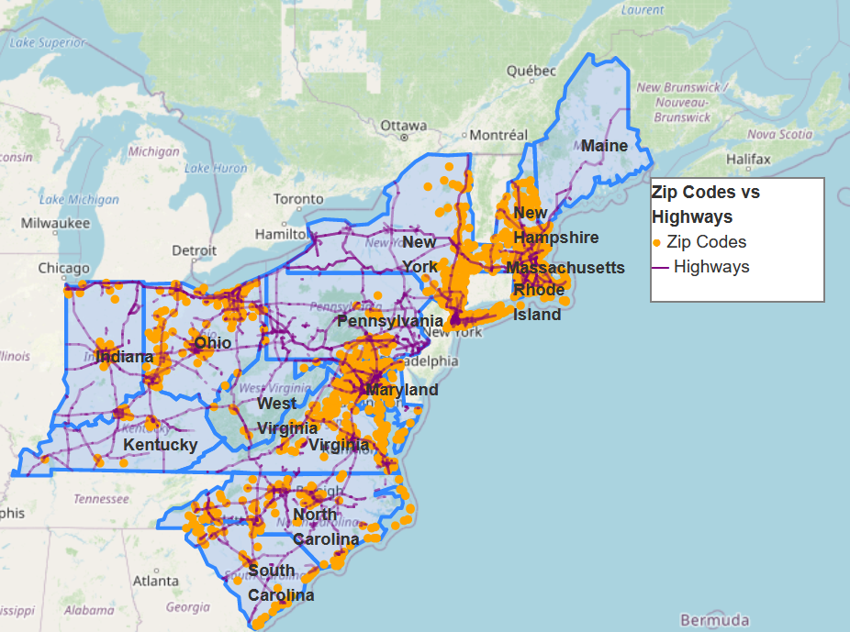
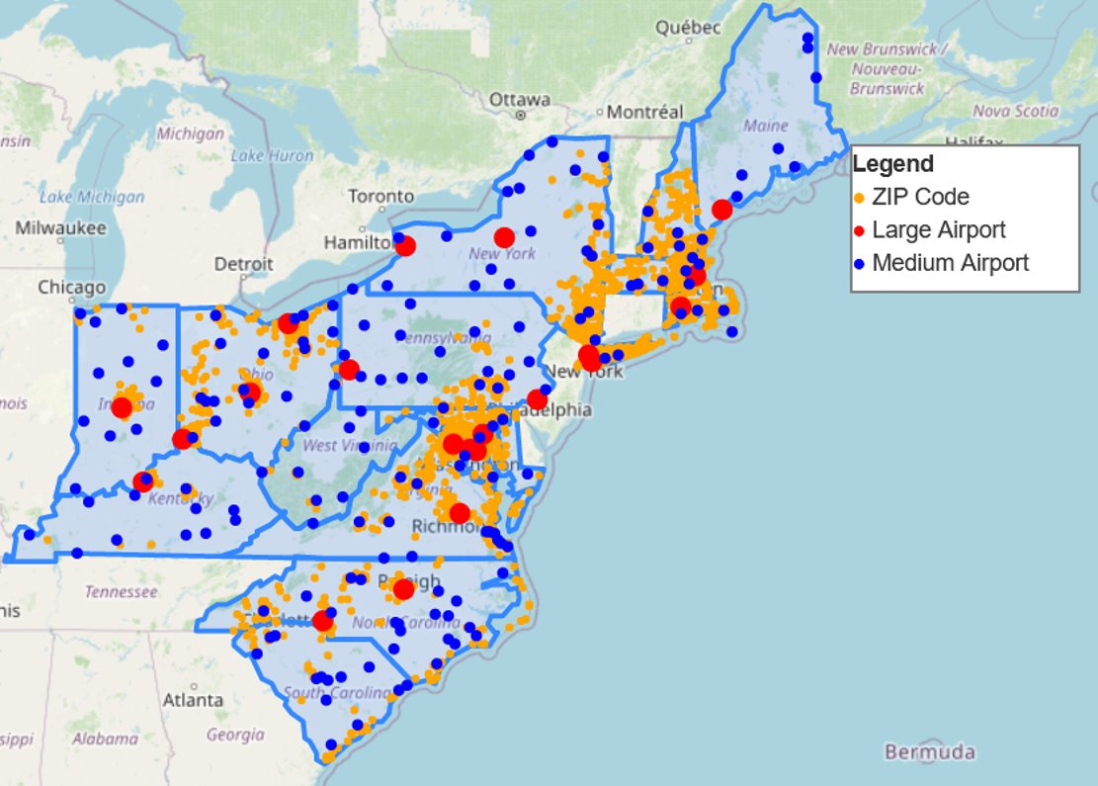
Geographical Relationships
Airports
Proximity to airports (large and medium sized) seem to be a distinguishing feature of the dataset.
Highways
Proximity to highways may be a distinguishing feature of this dataset.
Notes:
Highway
airport

Slide 5
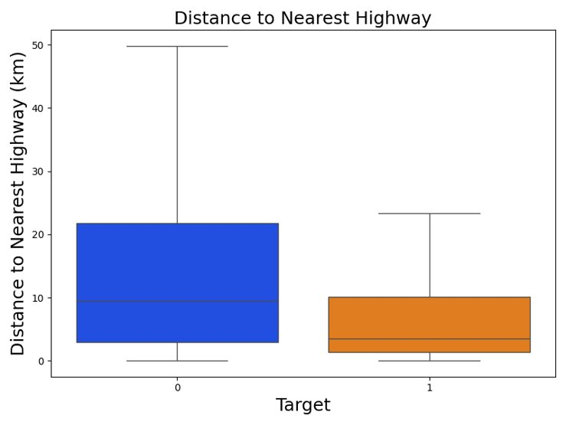
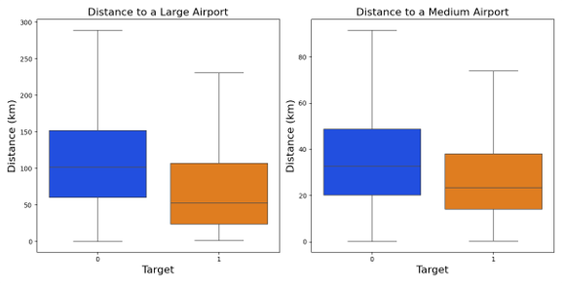
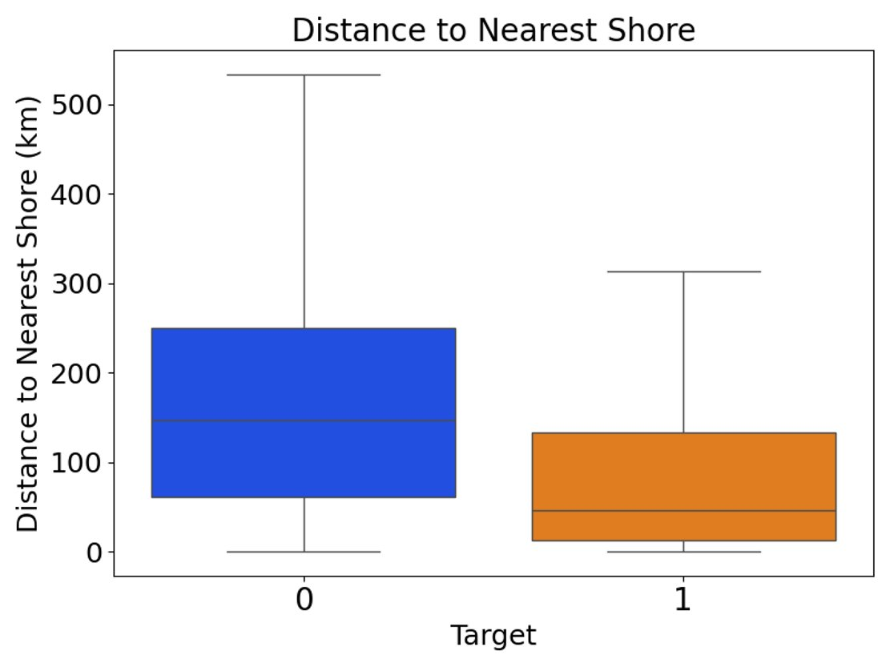
Geographical Analysis
p-value: 2.28e-05, effect size: -0.19
p-value: 8.16e-10, effect size: -0.27
p-value: 1.43e-01, effect size: -0.06
Proximity of target business locations to airports (large and medium –sized) and the shore is statistically significant.
p-value: 1.79E-31, effect size: -0.51

Slide 6
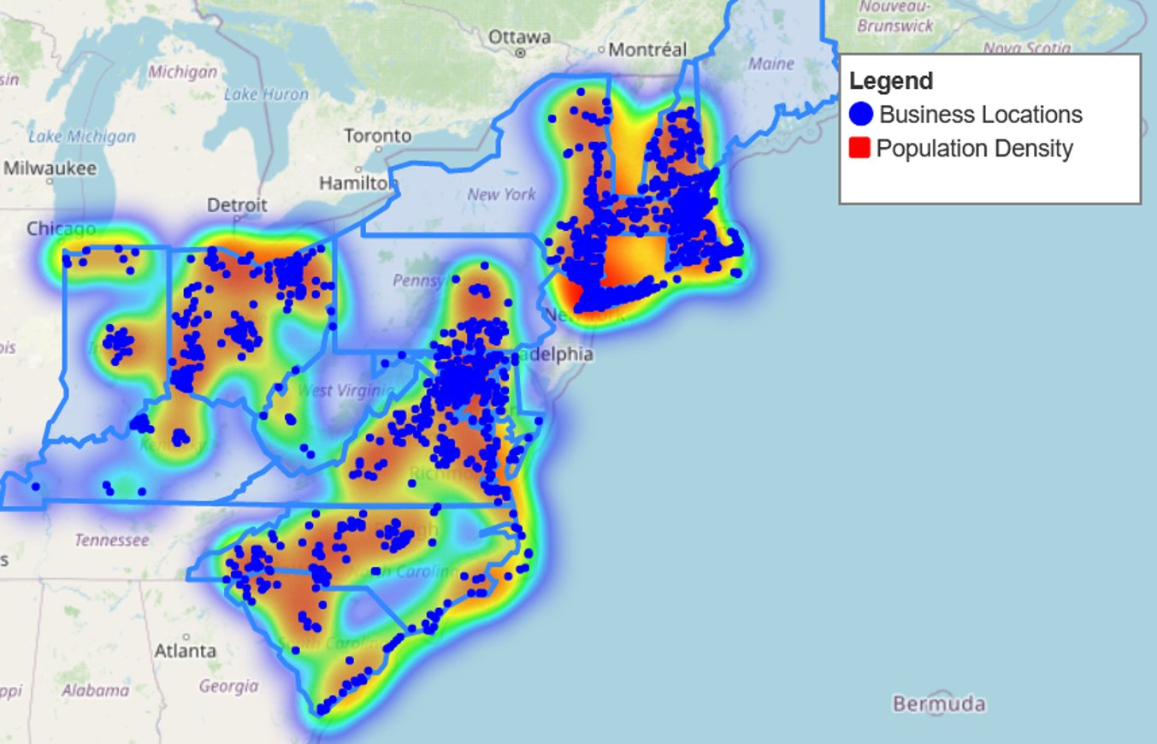
Population & Business Analysis
Information
The given business locations are located in areas with high population densities.
Visible from the overlap between given business locations and densely populated areas (as seen on the map).
Notes:
https://www.dropbox.com/scl/fi/de0puzbe696cv50218d3n/mika_population_density.html?rlkey=5b01vy8ksmxsuhsnougvd6hug&dl=0

Slide 7
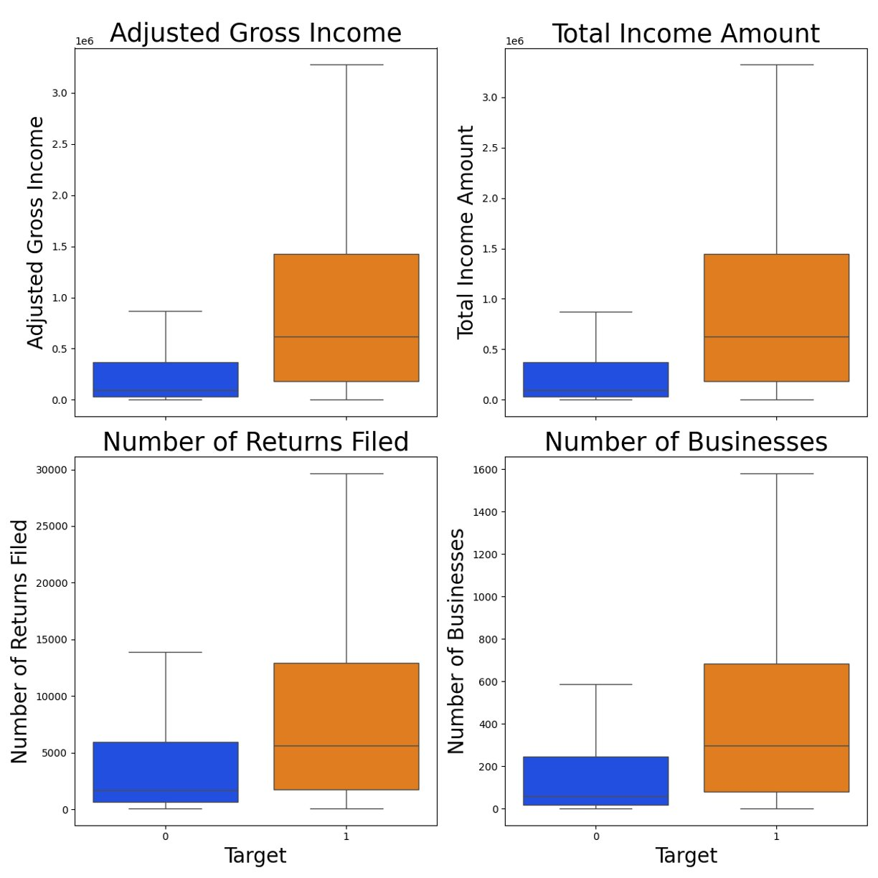
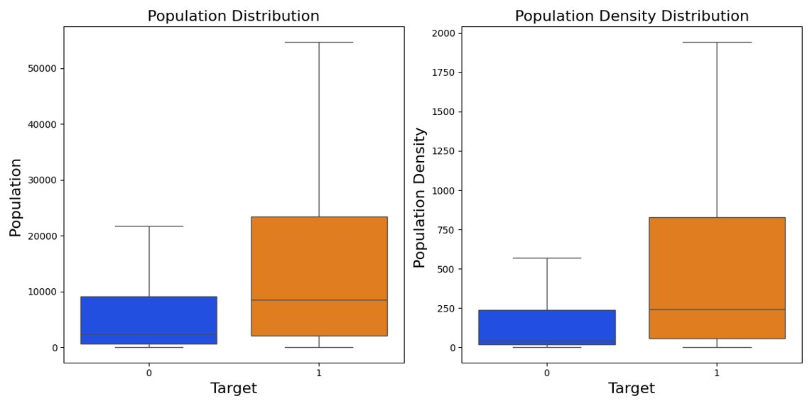
Population & Business Analysis
Feature | P-Value | Effect Size
Adjusted Gross Income | 1.10E-195 | 0.51
Total Income | 2.87E-196 | 0.52
Number of Returns | 6.46E-86 | 0.34
Number of Businesses | 5.63E-131 | 0.42
Population Distribution | 2.09e-73 | 0.31
Population Density | 6.32e-139 | 0.43
The effect of these features on target business locations are statistically significant.

Slide 8
Construction of Data
Zip Code | State ID | Target | PO Box | Population | Density | Distance to Large Airport | Distance to Medium Airport | Distance to Highway | Distance to Shore | Number of Businesses | Adjusted Gross Income | Total Income Amount | Number of Returns
1026 | MA | 1 | 0 | 1071 | 14.7 | 146.6 | 36.9 | 24.4 | 147.6 | 18.0 | 32,259.0 | 32,739.0 | 520.0
1029 | MA | 1 | 1 | 511 | 19.8 | 141.6 | 25.9 | 7.4 | 106.5 | 33 | 37714 | 38395 | 470
1035 | MA | 1 | 0 | 5293 | 88.5 | 118.0 | 17.7 | 4.1 | 125.7 | 309.0 | 227,576.0 | 231,353.0 | 2920.0
*Business and population features of PO Boxes are calculated from the closest regular zip code.
Notes:
For this slide please talk about the data extracted // columns [ esp. Ones not listed above] , the years the data spans from , and where the data was sourced from.

Slide 9
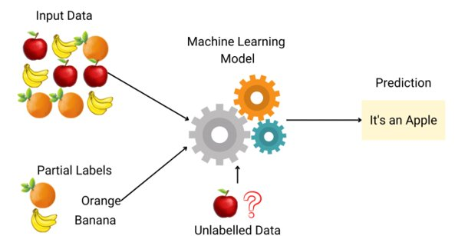
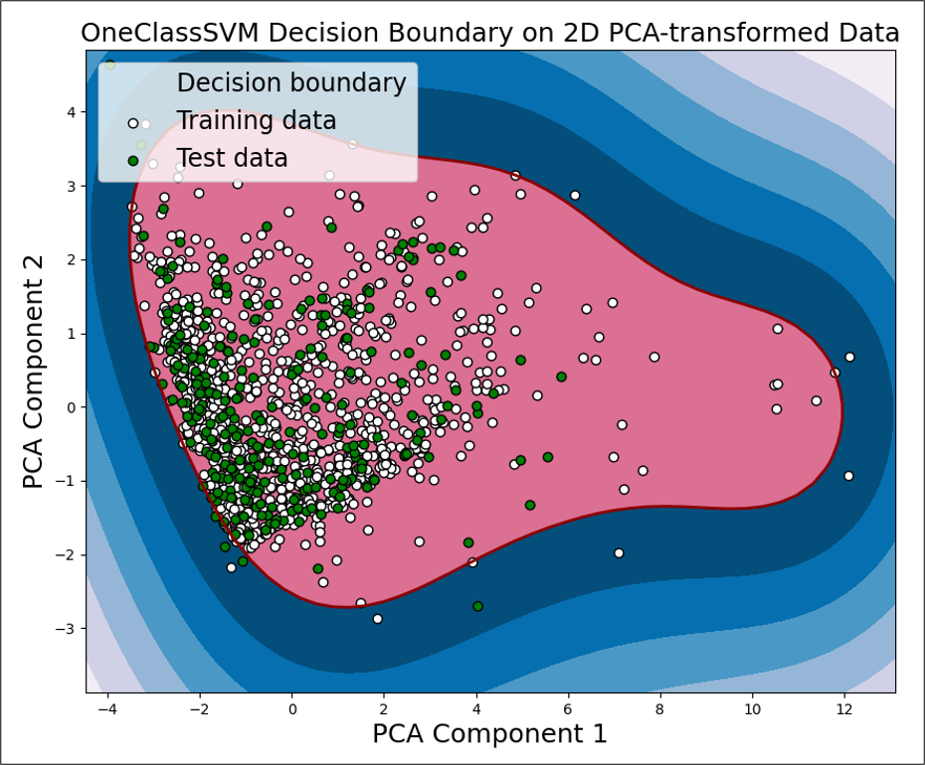
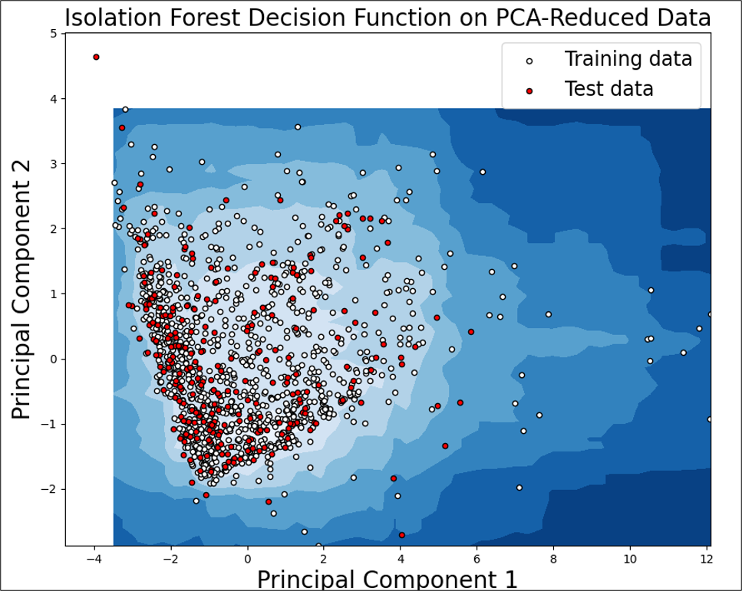
Location Prediction via Semi-Supervised Learning
Principial Componant Analysis(PCA) shows that data points are clustered→ we picked strong features to predict the promising locations…
Method | Train Accuracy(1200 Zips) | Test Accuracy(300 Zips)
One Class SVM | 97.92% | 98.03%
Isolation Forest | 98.00% | 97.00%

Slide 10
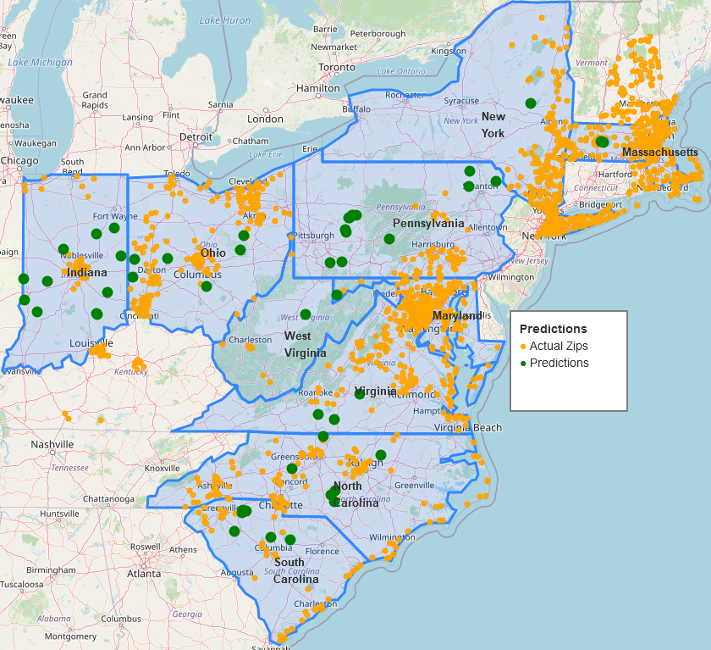
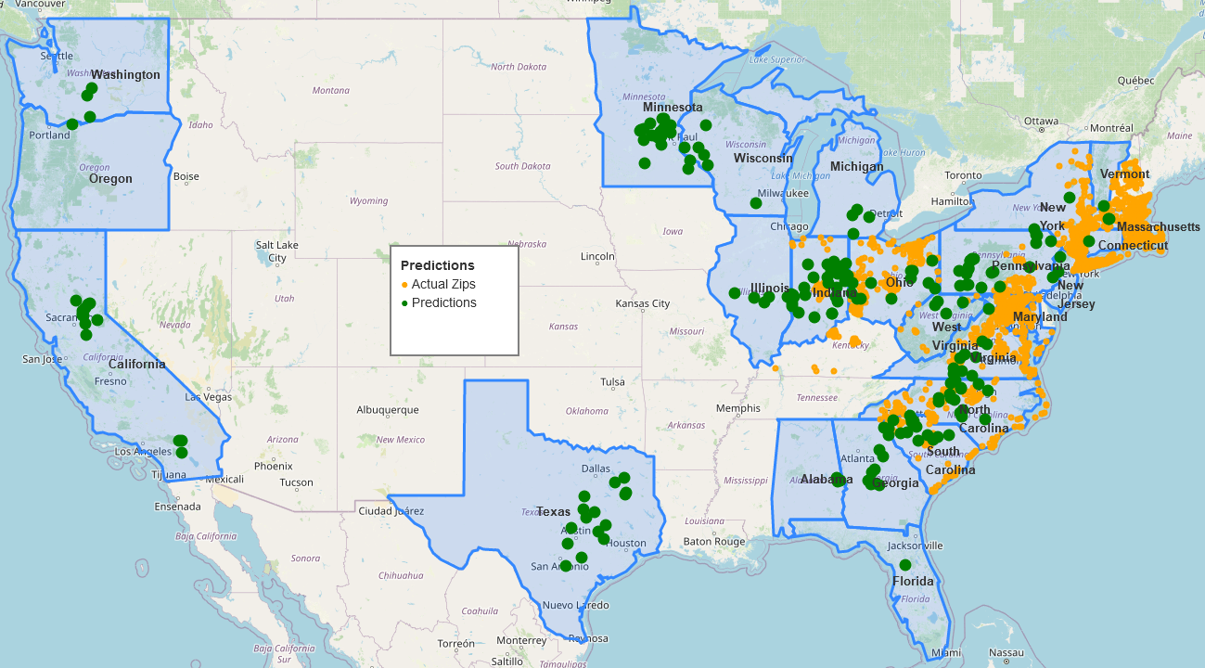
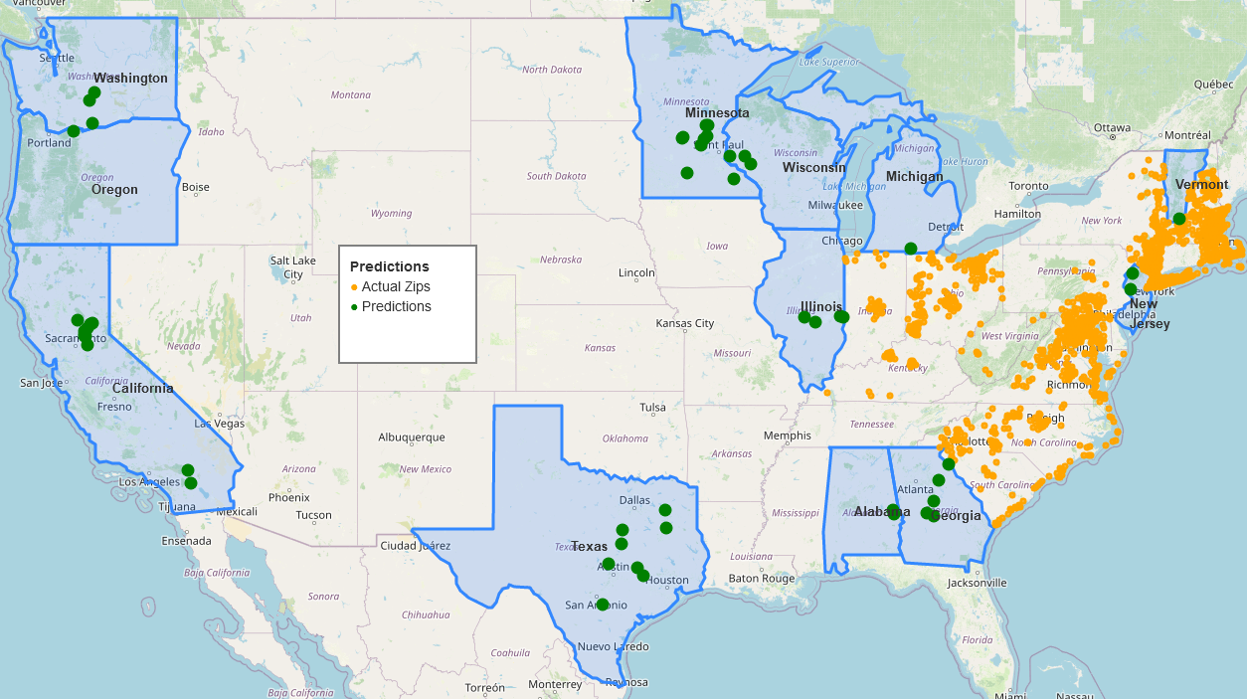
Expansion Suggestions
Existing
States
Top 50
99.5 percentile based on model score(199 zips)
New
States
Top 50

Slide 11
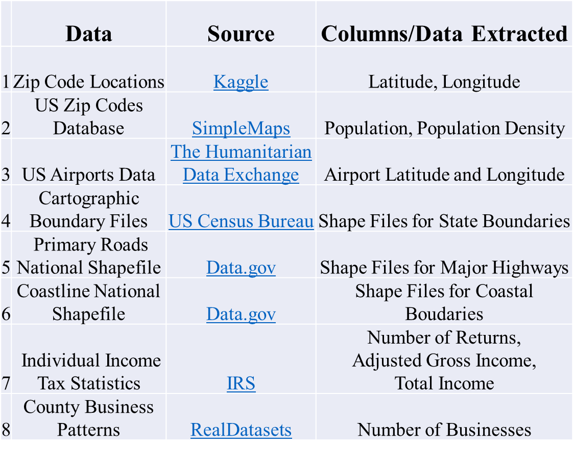








THANK YOU!
Tools Used
Data Sources

